Slide 1
Hack JCL: Interactive Map
Sophie Reynolds

Slide 2
Why?
A lot of students, myself included, struggle to memorize the geography of the Roman Empire. This map is a clean, simple way for teachers to present the main information. Students are also able to use the interactive features to test themselves and study.

Slide 3
Overview
Interactive map of the Roman Empire
Able to hover over territories to see the name
3 add on layers: Seas, Major Battles, Cities
These can be enabled and disabled

Slide 4
Technical Details
Used Python to write an HTML file
The HTML file contained a JS file and linked to a CSS file for formatting
The JavaScript used Leaflet, an open source mapping library
Using Leaflet, I read the GeoJSONs (a specific way to store geographical data), styled the layers, added interactivity, and added them to the map

Slide 5
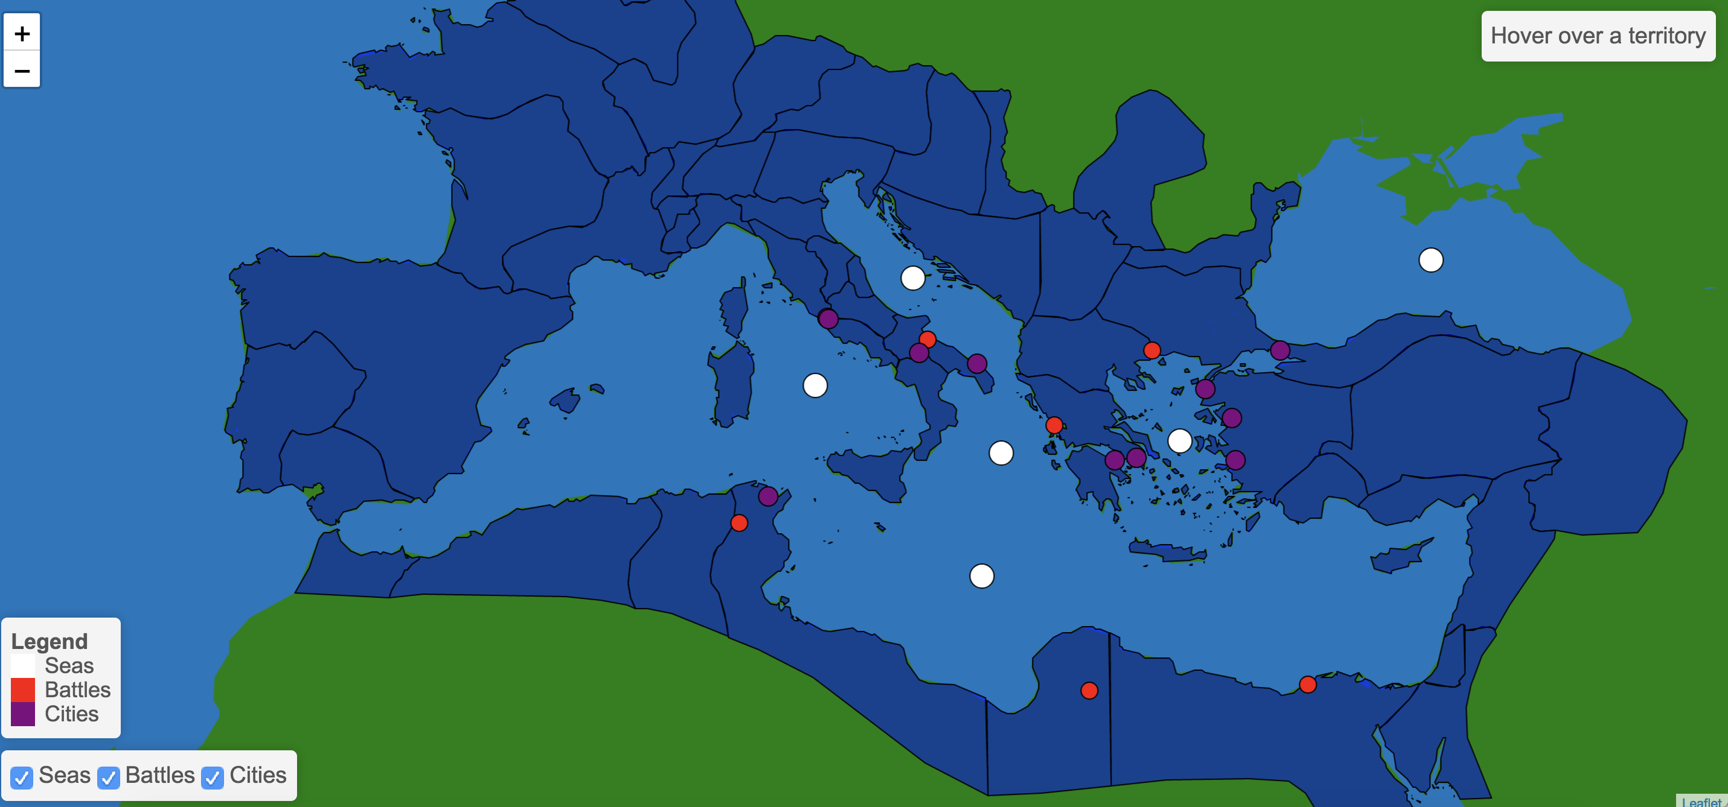
Notes:
Start up of map

Slide 6
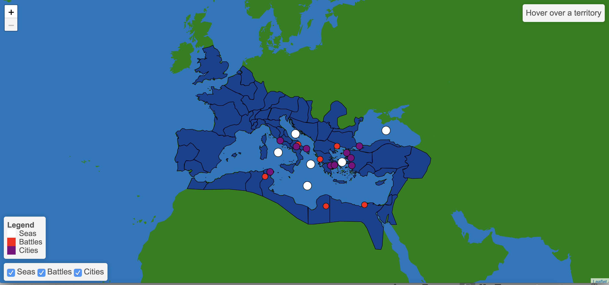
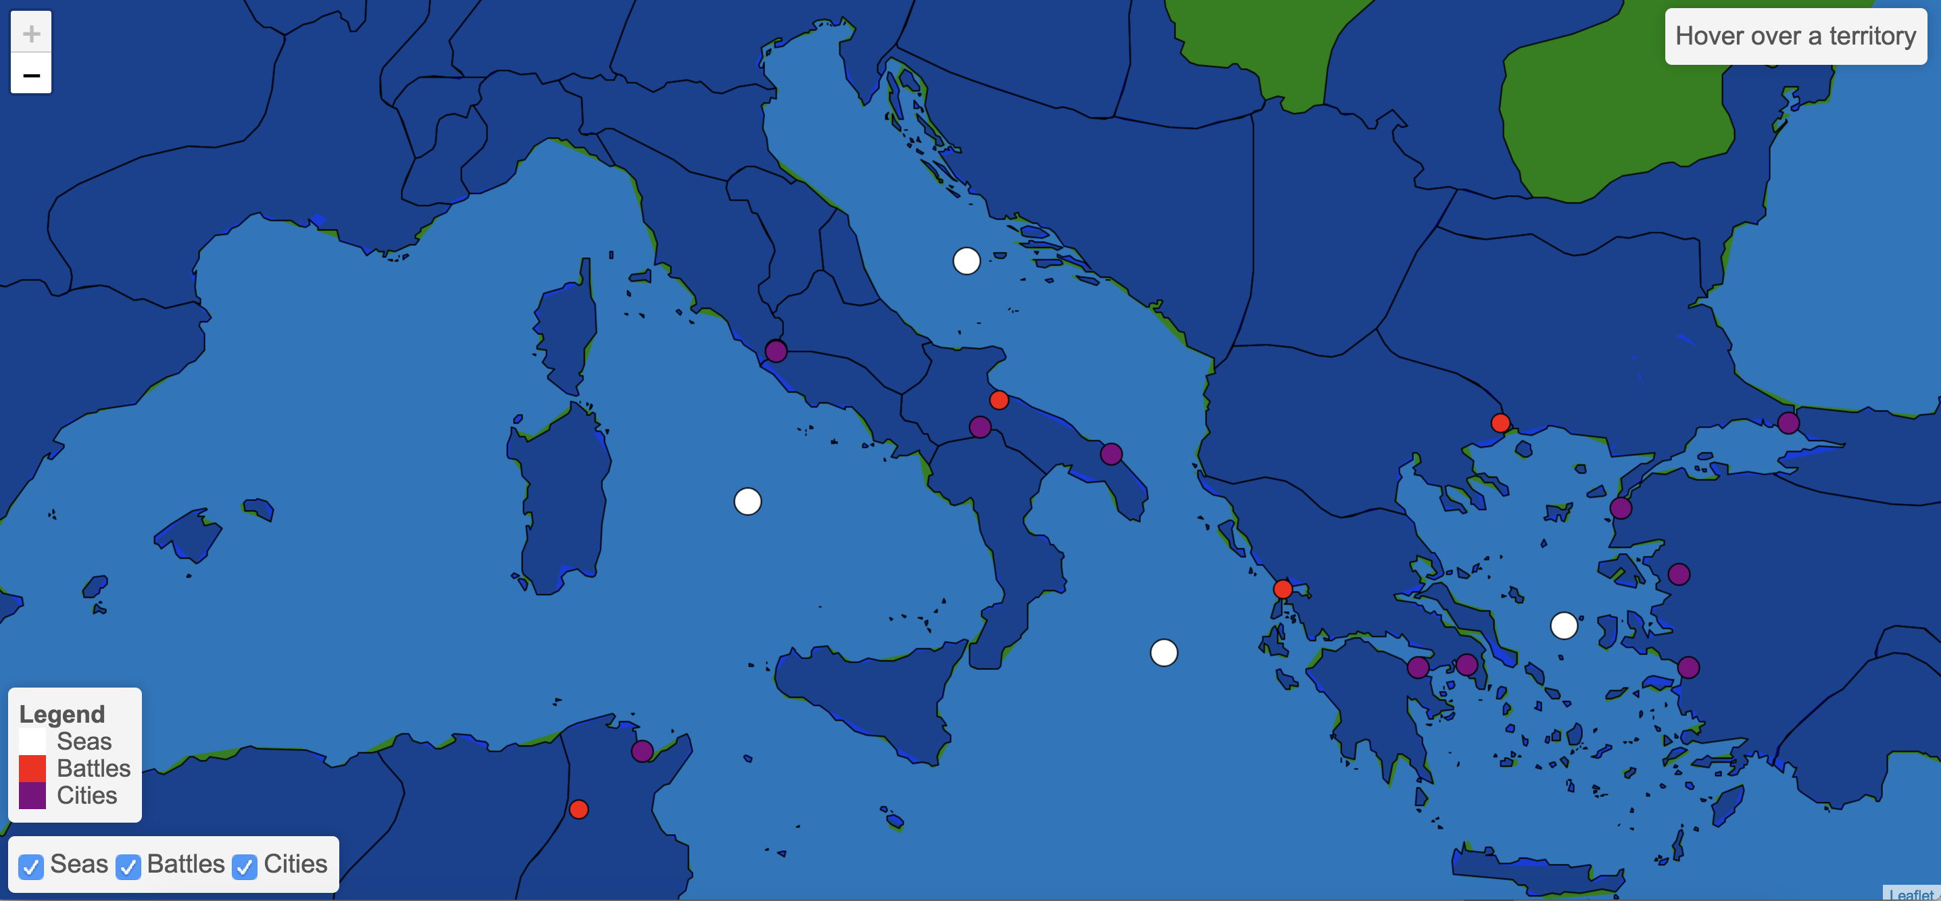
Notes:
Zoom in and out – see bigger picture or greater detail

Slide 7
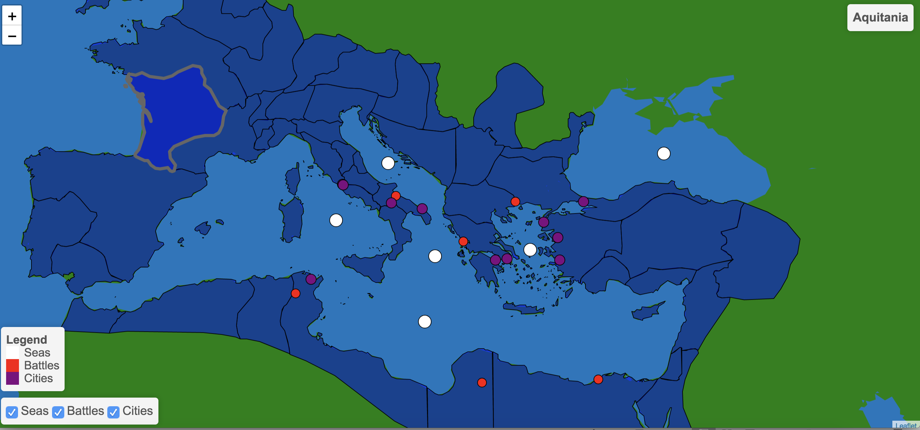
Notes:
Hovering over territories

Slide 8
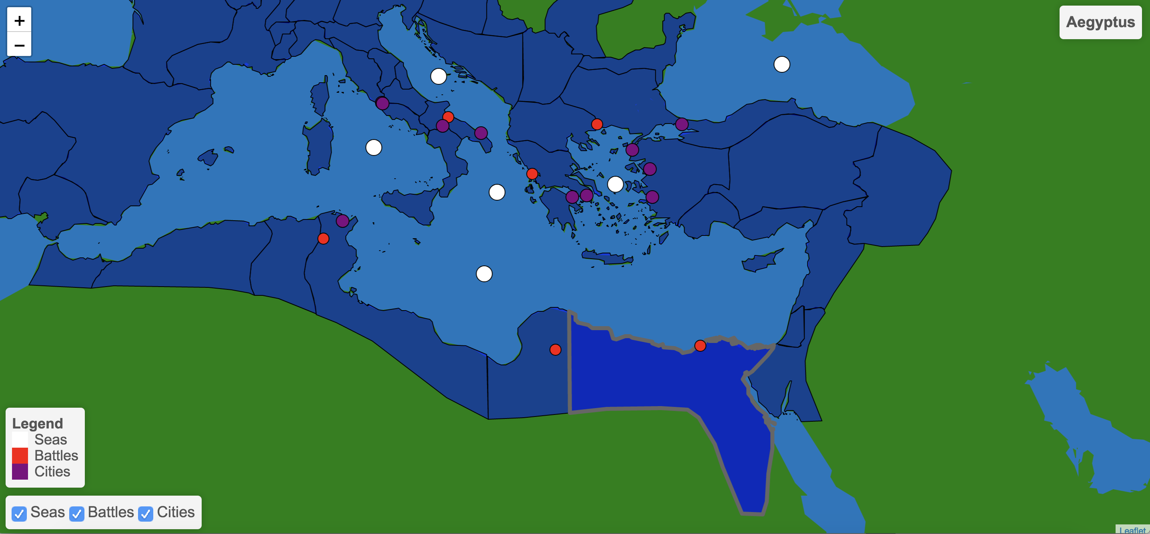
Notes:
Hovering part 2!

Slide 9
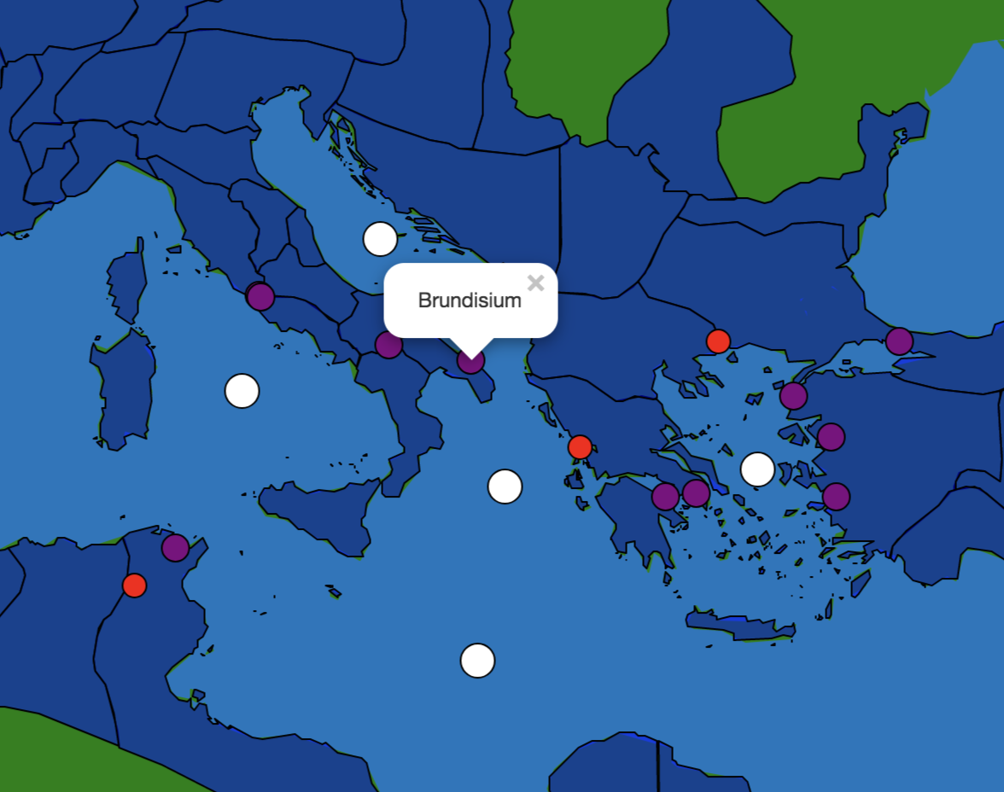
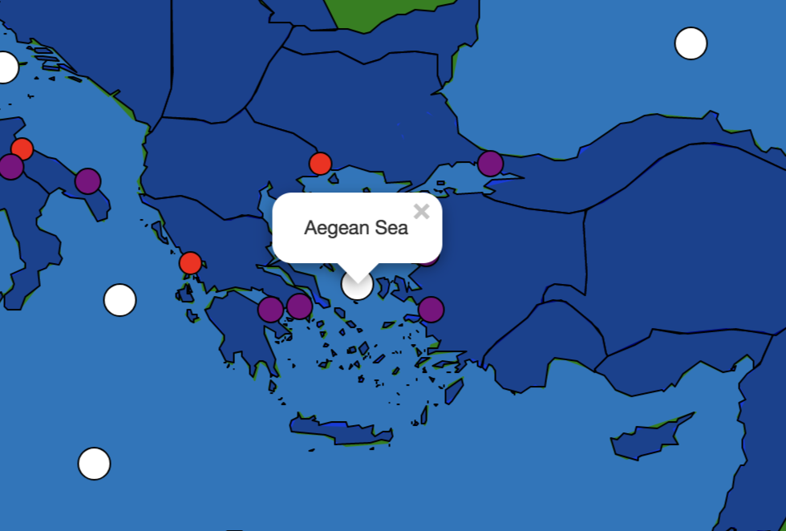
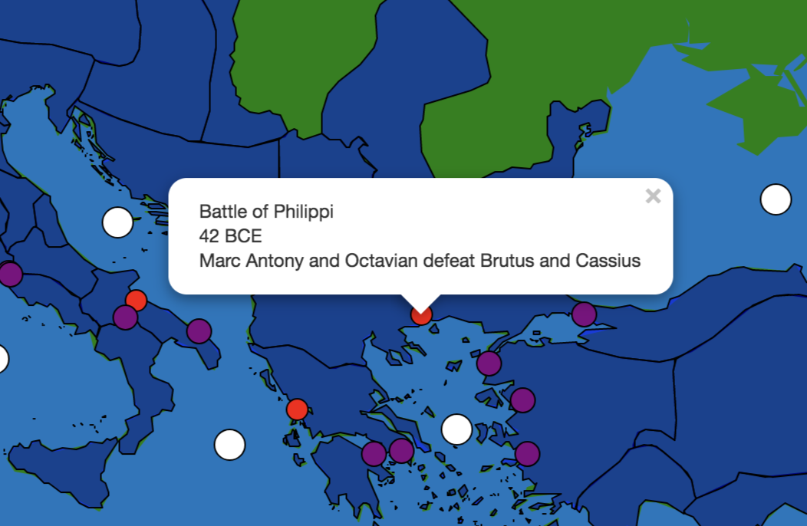
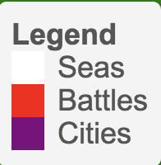
Notes:
Interactivity with cities, seas, and battles
Legend

Slide 10
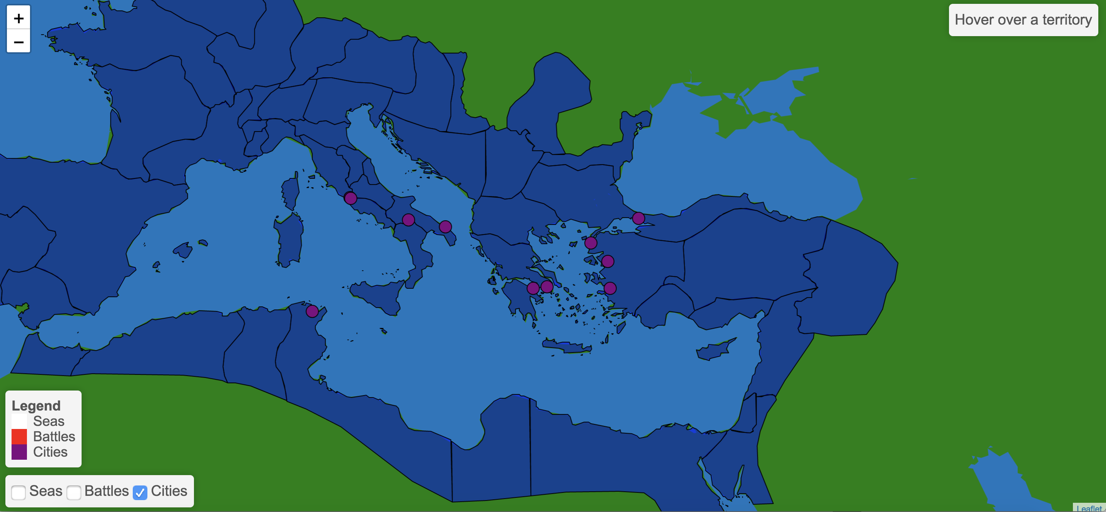
Notes:
Ability to focus on certain layers

Slide 11
Citations
Mapping: used open-source JavaScript library Leaflet
https://leafletjs.com/
Data for outline of territories: used a n open source GeoJSON from Github
https://github.com/klokantech/roman-empire/blob/master/data/provinces.geojson
Data for add on layers (cities, battles, seas): I created myself using information from Wikipedia and a free GeoJSON formatter
http://geojson.io/#map=2/20.0/0.0

